Slide 1

Group-4
AI automated Loan Approval and Disbursement System
Pralhad Vaishnav
Shreyas Tekawade
Samarth Mengji
Harish Yedulla
Abhijith Pillai
Sponsor- Prof. Michael Larche

Slide 2
Introduction
Efficient and fast loan application processing is critical in today's society, and lenders must be able to quickly assess creditworthiness, approve loans, distribute funds, and track loan activities.
Quick and accurate credit assessment is essential for lenders
Information system can handle loan request review, authorization, distribution, and tracking more efficiently
Implementing an efficient information system can reduce mistakes and fraud, and increase client satisfaction
Simplifying the lending process through an efficient information system can deliver faster and more reliable service to clients.

Slide 3
Proposed New System
The goal of this project was to create an AI-powered database that can do things like determine if a borrower is creditworthy, analyze loan applications, make lending decisions, disperse funds, and monitor repayment. The system's initial focus will be on loans to smaller businesses, with the potential for expansion to bigger loans in the future. The borrower and lender can exchange information and messages through the loan site.

Slide 4
Benefits
Faster loan approval process
Improved accuracy and consistency in decision-making
Better risk management and informed decision-making
Improved customer experience through a user-friendly loan portal and automated updates
Cost savings and scalability for future needs.

Slide 5

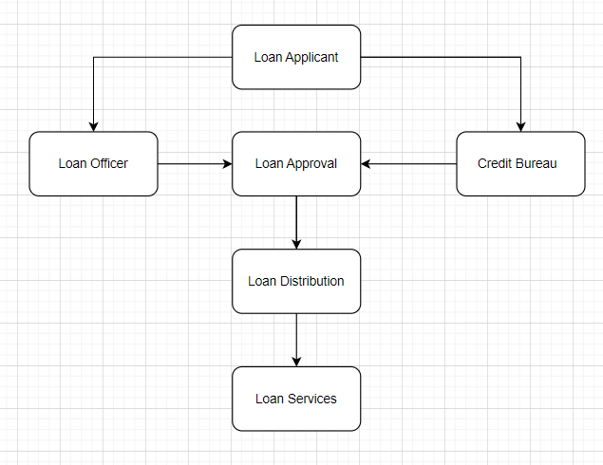
Level-0 DFD

Slide 6
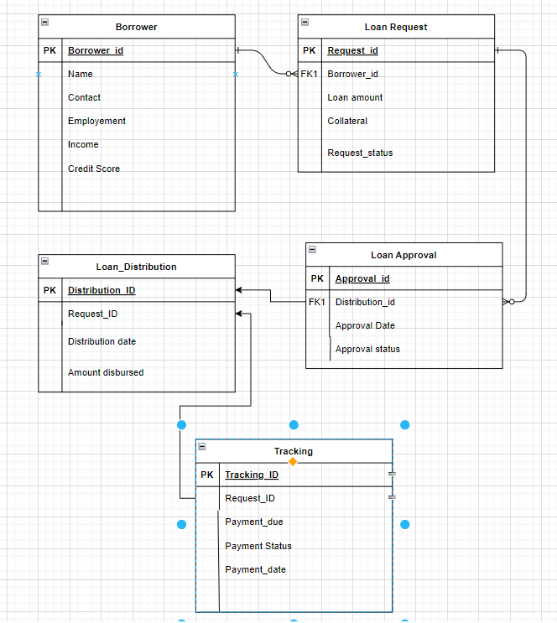
ER Diagram

Slide 7
Logical Model Explained
The loan approval, loan distribution, and loan tracking entities are used to manage the process of approving, distributing, and tracking loans.
Each loan approval, distribution, and tracking has a unique ID, as well as a request ID which links it to a specific loan request.
The approval date, distribution date, and payment due date are all tracked for each loan request.
Approval status, amount distributed, and payment amount are also tracked for each loan request, as well as payment status.
The borrower entity is used to manage information about the person or organization requesting the loan.
Each borrower can have zero or many loan requests, each of which has a unique request ID.
Employment information, purpose of the loan, income, collateral (if any), and credit score are all tracked for each loan request.
The borrower's contact information is also stored, including their name and borrower ID.
Finally, the request status is tracked for each loan request, which can help borrowers and lenders understand the progress of the loan application.
Overall, these entities and relationships help to manage the process of approving, distributing, and tracking loans, as well as manage information about borrowers and their loan requests.

Slide 8
Feedback from users
User feedback on the AI-powered loan database has been overwhelmingly positive.
Borrowers appreciate the easy-to-use platform and the quick turnaround time on loan decisions.
Lenders have reported that the system's algorithms are effective at assessing creditworthiness and identifying high-risk borrowers.
The ability for borrowers and lenders to communicate through the platform has streamlined the loan process and increased transparency.
Users have expressed interest in the system's potential for expansion to bigger loans in the future.
The system's monitoring and tracking features have helped borrowers stay on top of their repayment schedules, resulting in fewer delinquencies and defaults.
Overall, users have reported high levels of satisfaction with the system and its ability to facilitate lending to smaller businesses.

Slide 9
Testing
Testing is a critical component of the development process for any software application, including an AI-powered loan database.
The testing phase involved rigorous examination of the system's algorithms, functionality, security features, and user interface.
Multiple rounds of testing were conducted to ensure that the system could handle a variety of loan scenarios and user interactions.
Both manual and automated testing were used to identify and fix bugs, errors, and other issues that could impact the system's performance.
Extensive load testing was conducted to assess the system's ability to handle large volumes of loan applications and data.
The testing phase also involved working closely with beta users to gather feedback and make improvements to the system before its official launch.
Thanks to the comprehensive testing process, the AI-powered loan database is now a stable, reliable, and secure platform for borrowers and lenders.

Slide 10
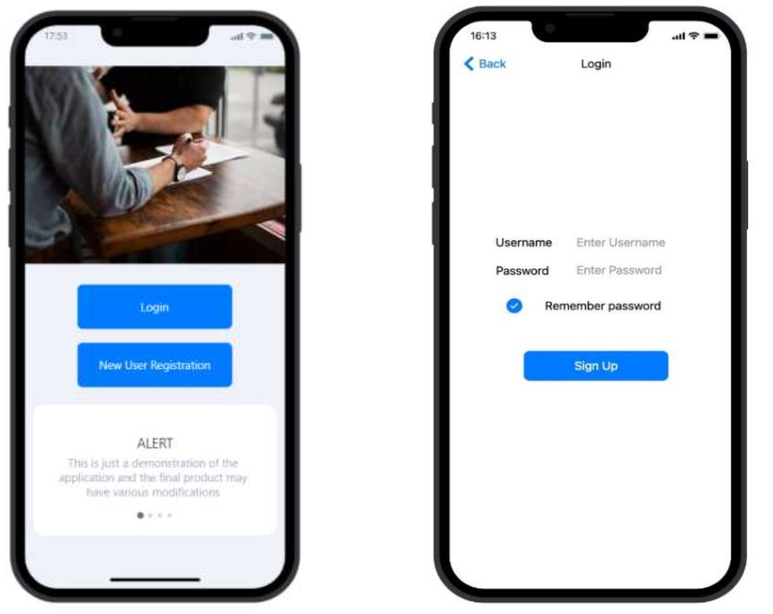
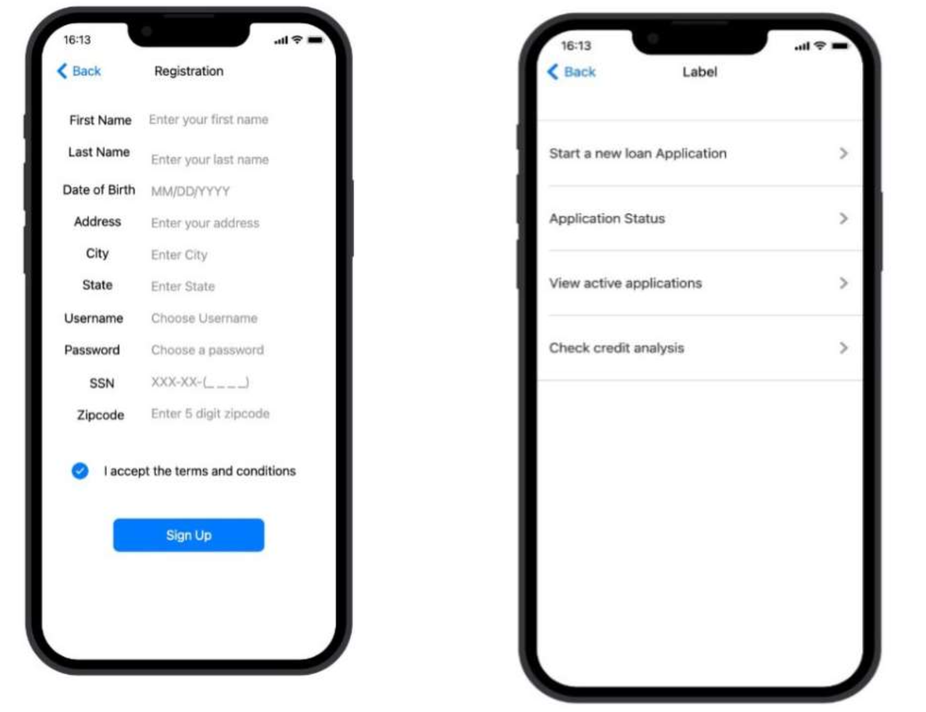
Implementation

Slide 11
Different Approach to the project?
Traditional Approach: In this approach, the project team would follow a well-defined, step-by-step process to develop the AI-powered loan database. The team would first gather requirements, then design the system, followed by implementation, testing, and deployment.
Agile Approach: In this approach, the project team would focus on delivering the most important features of the AI-powered loan database first and then gradually add more features based on user feedback. The team would work in short sprints, with frequent releases of working software.
Waterfall Approach: In this approach, the project team would follow a linear process, where each phase of the project is completed before moving on to the next phase. The team would gather all requirements, design the system, implement it, test it, and then deploy it.
Prototyping Approach: In this approach, the project team would create a basic version of the AI-powered loan database, known as a prototype, and then refine it based on user feedback. The team would iterate on the prototype until it meets all requirements.
Hybrid Approach: In this approach, the project team would combine elements of the traditional, agile, and prototyping approaches to suit the needs of the project. For example, the team might use agile methodologies for software development but also incorporate some traditional project management practices.
Each approach has its own advantages and disadvantages, and the project team should carefully consider which approach is best for their specific needs.

Slide 12
Lessons learned
Collaboration is key: Effective collaboration between team members, stakeholders, and end-users is essential for the success of the project. Regular communication, feedback, and collaboration ensure that the project stays on track and meets its objectives.
Testing is critical: Comprehensive testing and quality assurance are critical to ensure that the AI-powered loan database works as intended and meets user requirements. A robust testing process can identify and address issues early on in the development cycle, saving time and money in the long run.
Flexibility is important: The project team must be flexible and adaptable to changes in requirements, scope, and timelines. The ability to pivot and adjust quickly to new information or challenges is essential for project success.
User-centric design is crucial: Designing the AI-powered loan database with the end-user in mind is crucial to ensuring its effectiveness and adoption. Engaging users early in the design process and incorporating their feedback throughout the project can lead to a more user-friendly and effective system.
Documentation is essential: Documentation is crucial for the long-term maintenance and support of the AI-powered loan database. Creating comprehensive documentation throughout the development process can help future developers understand the system's functionality and make updates or improvements more efficiently.

Slide 13
Questions?

Slide 14
Thank you

